Slide 1
XML
EXtensible Markup Language

Slide 2
XML
XML is based on SGML: Standard Generalized Markup Language
HTML and XML are both based on SGML
SGML
HTML
XML

Slide 3
Diff b/w HTML & XML
HTML was designed to display data and to focus on how data looks.
HTML is about displaying information, while XML is about describing information
XML was designed to describe data and to focus on what data is.
It is important to understand that XML was designed to store, carry, and exchange data. XML was not designed to display data.

Slide 4
What is XML?
XML stands for EXtensible Markup Language
XML is a markup language much like HTML
XML was designed to describe data
XML tags are not predefined. You must define your own tags
Extensible: can be extended to lots of different applications.
Markup language: language used to mark up data.
Meta Language: Language used to create other languages.
XML uses a Document Type Definition (DTD) or an XML Schema to describe the data

Slide 5
HTML File
<HTML>
  <BODY>
      <H1>Harry Potter</H1>
      <H2>J. K. Rowling</H2>
      <H3>1999</H3>
      <H3>Scholastic</H3>
  </BODY>
</HTML>

Slide 6
XML File
<BOOK>
  <TITLE>Harry Potter</TITLE>
  <AUTHOR>J. K. Rowling</AUTHOR>
  <DATE>1999</DATE>
  <PUBLISHER>Scholastic</PUBLISHER>
</BOOK>

Slide 7
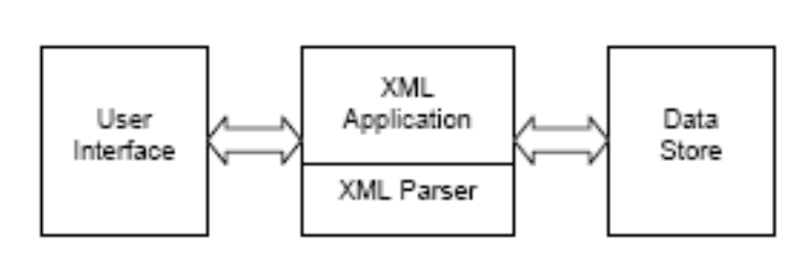
XML ROLE

Slide 8
XML Advantages
1. XML is used to Exchange Data
  With XML, data can be exchanged between incompatible systems
2. XML and B2B
  With XML, financial information can be exchanged over the Internet.
3. XML can be used to Share Data
  With XML, plain text files can be used to share data.

Slide 9
XML Advantages
4. XML is free and extensible
  XML tags are not predefined. we must "invent" your own tags.
5. XML can be used to Store Data
  With XML, plain text files can be used to store data.
6. XML can be used to Create new Languages
  XML is the mother of WAP and WML.
7. HTML focuses on "look and feel”
  XML focuses on the structure of the data.

Slide 10
XML Example
<!-- This is a comment -->
<?xml version="1.0" encoding="ISO-8859-1"?>
<book>
  <title>My First XML</title>
  <prod id="33-657" Media="paper"></prod>
  <chapter>Introduction to XML
    <para>What is HTML</para>
    <para>What is XML</para>
  </chapter>
  <chapter>XML Syntax
    <para>Elements must have a closing tag</para>
    <para>Elements must be properly nested</para>
  </chapter>
</book>

Slide 11
Elements can have different content types.
Element content → book
Mixed content → Chapter
Simple content → para
Empty content → prod

Slide 12
Element Naming rules
Names can contain letters, numbers, and other characters
Names must not start with a number or punctuation character
Names must not start with the letters xml (or XML, or Xml, etc)
Names cannot contain spaces
Avoid "-" and "." in names. For example, if you name something "first-name," it could be a mess if your software tries to subtract name from first. Or if you name something "first.name," your software may think that "name" is a property of the object "first."

Slide 13
Element Naming rules
Names should be short and simple
XML documents often have a corresponding database, in which fields exist corresponding to elements in the XML document.
Attribute values must always be enclosed in quotes, but either single or double quotes can be used.
Ex: <person sex="female">

Slide 14
XML Attributes
XML elements can have attributes. Attributes are used to provide additional information about elements.
In HTML → <IMG SRC="computer.gif">.
  The SRC attribute provides additional information about the IMG element.
In XML →
  <prod id="33-657" media="paper"></prod>

Slide 15
Use of Elements vs. Attributes
Data can be stored in child elements or in attributes.
Attributes:
<person sex="female">
<firstname>Anna</firstname> <lastname>Smith</lastname>
</person>
Elements:
<person>
  <sex>female</sex>
  <firstname>Anna</firstname> <lastname>Smith</lastname>
  </person>

Slide 16
Well-formedness
A well-formed XML document conforms to XML syntax rules and constraints, such as:
  The document must contain exactly one root element and all other elements are children of this root element.
   All markup tags must be balanced; that is, each element must have a start and an end tag.
  Elements may be nested but they must not overlap.
   All attribute values must be in quotes.

Slide 17
Validity
According to the XML specification, an XML document is considered valid if it has an associated DTD declaration and it complies with the constraints expressed in the DTD.
To be valid, an XML document must meet the following criteria:
   Be well-formed
   Refer to an accessible DTD-based schema using a Document Type Declaration:
<!DOCTYPE>

Slide 18
Document Type Definitions
The Document Type Definition (DTD) forms the basis of valid documents because it establishes the grammar of an XML vocabulary, which in turn determines the structure of XML documents.
A DTD is necessary for performing document validation, which is an important part of XML content development and deployment.

Slide 19
Syntax of DTD
ELEMENT is used to declare element names
<!ELEMENT element_name (subelement1,subelement2......subelement(n-1))>
  Ex: <!ELEMENT product (name, type)>
ATTLIST To declare attributes
<!ATTLIST element_name attr1_name att_type constraints [att2_name att_type constraints...........]>
  <!ATTLIST product name CDATA #REQUIRED>

Slide 20
Attribute Types
Types Description
CDATA Unparsed character data
Enumerated a series of string values
ID A unique identifier
IDREF A reference to an ID declared somewhere
NMTOKEN A name consisting of XML token characters
NMTOKENS Multiple names consisting of XML token characters.

Slide 21
Internal DTD
<!DOCTYPE root_ele_name [
DTD code
]>

Slide 22
InternalDTDs
Placing the DTD code in the DOCTYPE tag in this way
products.xml
<?xml version="1.0" encoding="UTF-8"?>
<!DOCTYPE products [
<!ELEMENT PRODUCTS (PRODUCT*)>
<!ELEMENT PRODUCT (PID,PNAME,PRICE,DESCR,ISTOCK)>
<!ELEMENT PID (#PCDATA)>
<!ELEMENT PNAME (#PCDATA)>
<!ELEMENT PRICE (#PCDATA)>
<!ELEMENT DESCR (#PCDATA)>
<!ELEMENT ISTOCK (#PCDATA)>
]>
<PRODUCTS>
<PRODUCT>
<PID>1</PID>
<PNAME>XYZ</PNAME>
<PRICE>300.00</PRICE>
<DESCR>XYZ descr</DESCR>
<ISTOCK>1000</ISTOCK>
</PRODUCT>
</PRODUCTS>

Slide 23
External DTD
<!DOCTYPE root_ele_name SYSTEM 'dtd file name'>
  SYSTEM →the definitions are developed and used by the same comp
or
<!DOCTYPE root_ele_name PUBLIC ' fpi string ' ' dtd url '>
  PUBLIC →if the definition can be used by public

Slide 24
What is DOCTYPE
The !DOCTYPE declaration is a top-level tag-like reference known as a Public Text Identifier. It should appear at the very beginning of an HTML/XHTML document in order to identify the content of the document as conforming (theoretically) to a particular HTML DTD specification

Slide 25
Typical HTML DOCTYPE statement
<!DOCTYPE HTML PUBLIC ” - //W3C//DTD HTML 4.0
(1) (2) (3) (4) (5) (6)
Transitional//EN” "http://www.w3.org/TR/html4/loose.dtd">
(7) (8)

Slide 26
Annotated syntax
<!DOCTYPE [Top Element] [Availability]
(1) (2)
"[Registration]//[Organization]//[Type] [Label]
(3) (4) (5) (6)
//[Language]" "[URL]">
(7) (8)

Slide 27
Explanation of FPI string
General : A pair of forward slash characters ("//") is used as delimiters between keyword fields in the FPI declaration.
(1) : [Top Element] - Indicates the top level element type declared in the DTD; for HTML it is <html>.
(2) : [Availability] - field indicates whether the identifier is a publicly accessible object (PUBLIC) or a system resource (SYSTEM) such as a local file or URL. HTML/XHTML DTDs are specified by PUBLIC identifiers.
(3) : [Registration] - Indicated by either a plus ("+") or minus ("-"). A plus symbol indicates that the organization name that follows is ISO-registered. A minus sign indicates the organization name is not registered. The IETF and W3C are not registered ISO organizations and thus use a "-".

Slide 28
(4) : [Organization] - This is the "OwnerID" - a unique label indicating the name of the entity or organization responsible for the creation and/or maintenance of the artifact (DTD, etc.) being referenced by the DOCTYPE. The IETF and W3C are the two originating organizations of the official HTML/XHTML DTDs.
(5) : [Type] - This is the "Public Text Class" - the type of object being referenced. There are many different keywords possible here, but in the case of an HTML/XHTML DTD, it is "DTD" - a Document Type Definition.
(6) : [Label] - This is the "Public Text Description" - a unique descriptive name for the public text (DTD) being referenced. If the public text changes for any reason, a new Public Text Description string should be created for it.
(7) : [Language] - This is the "Public Text Language"; the natural language encoding system used in the creation of the referenced object. It is written as an ISO 639 language code (uppercase, two letters.) HTML/XHTML DTDs are usually (always?) written in English ("EN".)
(8) : [URL] - This is the optional explicit URL to the DTD being referenced.

Slide 29
Building blocks of XML docs.
Elements
Tags
Attributes
Entities
PCDATA
CDATA

Slide 30
Declaring an Element
<!ELEMENT element-name category>
or
<!ELEMENT element-name (element-content)>
example:
<!ELEMENT element-name EMPTY> EMPTY is category.
Element with character data.
<!ELEMENT element-name (#PCDATA)>
example:<!ELEMENT from (#PCDATA)>

Slide 31
<!ELEMENT element-name (child-element-name)>
or
<!ELEMENT element-name (child-element-name,child-element-name,.....)>
Declaring only one occurrence of the same element
<!ELEMENT element-name (child-name)>.
Declaring minimum one occurrence of the same element
<!ELEMENT element-name (child-name+).
Declaring zero or more occurrences of the same element
<!ELEMENT element-name (child-name*)>.
Declaring zero or one occurrences of the same element
<!ELEMENT element-name (child-name?)>.
Declaring either/or content
<!ELEMENT element(child11|child12)>.

Slide 32
Declaring Attributes:
syntax
<!ATTLIST element-name attribute-name attribute-type default-value>.
example:
<!ATTLIST book rating CDATA "bad">
<book rating="good" />
Attribute types
CDATA The value is character data
(en1|en2|..) The value must be one from an enumerated list
ID The value is a unique id
etc.

Slide 33
Specifying a Default attribute value
DTD:
<!ELEMENT square EMPTY>
<!ATTLIST square width CDATA "0">
Valid XML:
<square width="100" />
<square /> indicates that the width is 0.

Slide 34
<!ATTLIST contact fax CDATA #IMPLIED>
Valid XML:
<contact fax="555-667788" />
Valid XML:
<contact />
Note :
  Use the #IMPLIED keyword if you don't want to force the author to include an attribute and you don't have an option for a default value.

Slide 35
Syntax :
<!ATTLIST element-name attribute_name attribute-type #REQUIRED>
Example
DTD:
<!ATTLIST person number CDATA #REQUIRED>
Valid XML:
<person number="5677" />
Invalid XML:
<person />

Slide 36
#FIXED
Syntax
<!ATTLIST element-name attribute-name attribute-type #FIXED "value">
Example
DTD:
<!ATTLIST sender company CDATA #FIXED "Microsoft">
Valid XML:
<sender company="Microsoft" />
Invalid XML:
<sender company="W3Schools" />

Slide 37
<!-- this example shows how to define entities that can be used as replacement text (variable) -->
<?xml version="1.0"?>
<!DOCTYPE PurchaseOrder[
<!ELEMENT PurchaseOrder (POLINE+)>
<!ELEMENT POLINE (itemid,qty)> <!-- this is to indicate that a poline element should contain another two items itemid and qty-->
<!ELEMENT itemid (#PCDATA)>
<!ELEMENT qty (#PCDATA)>
<!ENTITY five "5">
]>
We have to use the following syntax when declaring attributes in XML
<!ATTLIST element-name attribute-name attribute-type default-value>
In the above example ID is used to indicate a unique value should be used. From the above dtd we can write an XML document as shown below.
<PurchaseOrder pono="1">
<POLINE>
<itemid>101</itemid>
<qty>10</qty>
</POLINE>
<POLINE>
<itemid>111</itemid>
<qty>&five;</qty>
</POLINE>
</PurchaseOrder>

Slide 38
products.dtd
<!ELEMENT products (product)>
<!ELEMENT product (name, type)>
<!ELEMENT name (#PCDATA)>
<!ELEMENT type (#PCDATA)>
products.xml
<?xml version ="1.0"?>
<!DOCTYPE products SYSTEM "products.dtd">

Slide 39
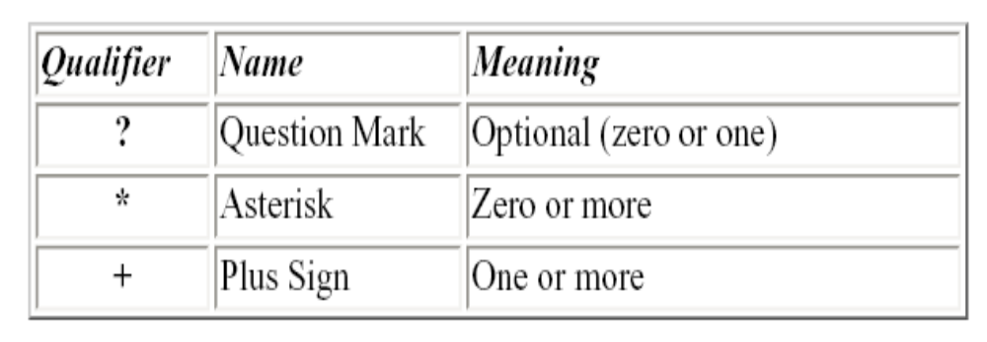
Qualifier Name Meaning
Ex : <!ELEMENT emp_details (emp+)>

Slide 40
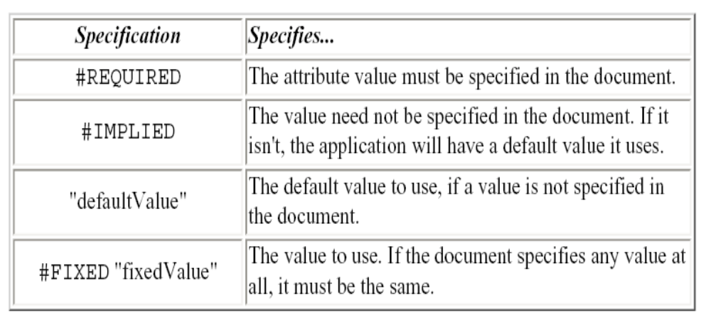
Attribute Values
<!ATTLIST product name CDATA #REQUIRED>

Slide 41
<!-- this example shows how to write a DTD -->
<!-- po1.dtd →
  <?xml version="1.0"?>
  <!DOCTYPE PurchaseOrder[
  <!ELEMENT PurchaseOrder (POLINE+)>
  <!ELEMENT POLINE (itemid,qty)> <!-- this is to indicate that a poline
  element should contain another two items itemid and qty-->
  <!ELEMENT itemid (#PCDATA)>
  <!ELEMENT qty (#PCDATA)>
  ]>
  + is to indicate that this element can occur for one or more no of times.
  ? is used to represent that the element can occur for zero or one time.
  * is used to represent zero or more times.
  Using the above dtd we can create a xml document as shown above (assuming that the above dtd is stored in po1.dtd file.
<!DOCTYPE PurchaseOrder SYSTEM “po1.dtd”>
<PurchaseOrder>
<POLINE>
<itemid>101</itemid>
<qty>10</qty>
</POLINE>
<POLINE>
<itemid>111</itemid>
<qty>111</qty>
</POLINE>
</PurchaseOrder>

Slide 42
  <!-- this example shows how to define attributes that can be used with
  element -->
  <!– po1.dtd →
  <?xml version="1.0"?>
  <!DOCTYPE PurchaseOrder[
  <!ELEMENT PurchaseOrder (POLINE+)>
  <!ELEMENT POLINE (itemid,qty)> <!-- this is to indicate that a poline
  element should contain another two items itemid and qty-->
  <!ELEMENT itemid (#PCDATA)>
  <!ELEMENT qty (#PCDATA)>
  <!ATTLIST PurchaseOrder pono #ID #REQUIRED>
  ]>
  We have to use the following syntax when declaring attributes in XML
  <!ATTLIST element-name attribute-name attribute-type default-value>
  In the above example ID is used to indicate a unique value should be used.
  From the above dtd we can write an XML document as shown below.
  <!DOCTYPE PurchaseOrder SYSTEM “po1.dtd”>
  <PurchaseOrder pono="1">
  <POLINE>
  <itemid>101</itemid>
  <qty>10</qty>
  </POLINE>
  <POLINE>
  <itemid>111</itemid>
  <qty>111</qty>
  </POLINE>
  </PurchaseOrder>

Slide 43
XML Schema
XML Schema is an XML-based alternative to DTD.
An XML schema describes the structure of an XML document.
The XML Schema language is also referred to as XML Schema Definition (XSD).

Slide 44
XML Schema
An XML Schema:
defines elements that can appear in a document
defines attributes that can appear in a document
defines which elements are child elements
defines the order of child elements
defines the number of child elements
defines whether an element is empty or can include text
defines data types for elements and attributes

Slide 45
Schema | Serves as the root element for XML schema documents
Datatype | Describes data types for elements and attributes
ElementType | Describes a type of element
Element | Identifies an element that can occur with in another element type
Attribute type | Describes a type of attribute
Attribute | Identifies an attribute that can occur within an element type
Description | Provides documentation for an element or attribute

Slide 46
XML Schema Example
<xs:element name="employee">
<xs:complexType>
    <xs:sequence>
    <xs:element name="firstname" type="xs:string"/>
    <xs:element name="lastname" type="xs:string"/> </xs:sequence>
    </xs:complexType>
    </xs:element>

Slide 47
Diff b/w DTD & XSD
DTD supports types ID,IDREF,CDATA etc.,
Schema supports all primitive and user defined data types
DTD supports No specifier, ?, *, + sign
Schema hava minOccurs and maxOccurs attributes
XML Schemas are extensible to future additions
XML Schemas are richer and more powerful than DTDs
XML Schemas are written in XML

Slide 48
Parsers
An XML parser is a piece of code that reads a document and analyzes its structure.
The parser is the engine for interpreting our XML documents
The parser reads the XML and prepares the information for your application.
How to use a parser
1. Create a parser object
2. Pass your XML document to the parser
3. Process the results

Slide 49
Parser Example
import com.ibm.xml.parser.*;
import java.io.*;
public class SimpleParser
{ public static void main (String a[]) throws Exception
{ Parser p=new Parser("err");
FileInputStream fis=new FileInputStream(a[0]);
TXDocument doc=p.readStream(fis);
doc.printWithFormat(new OutputStreamWriter(System.out));
}
}

Slide 50
Types of Parsers
There are two common APIs that parsers use.
  DOM is the Document Object Model API
  SAX is the Simple API for XML

Slide 51
Document Object Model (DOM)
DOM uses a tree based structure.
DOM reads an entire XML document and builds a Document Object.
  The Document object contains the tree structure.
  The top of the tree is the root node.
  The tree grows down from this root, defining the child elements.
  DOM is a W3C standard.
Using DOM, we can also perform insert nodes, update nodes, and deleting nodes.

Slide 52
DOM interfaces
Node: The base data type of the DOM. Methods:
Element:
  Attr: Represents an attribute of an element.
  Text: The actual content of an Element or Attribute
Document: Represents the entire XML document. A Document object is often referred to as a DOM tree.

Slide 53
Node
getChildNodes(), getNodeName(), getNodeValue(), hasChildNodes().
NodeList
getLength()
item()
Document
createElement(),
createAttribute(),
createTextNode(),
Element

Slide 54
Simple API for XML Parsing (SAX)
SAX parsers are event-driven
  The parser fires an event as it parses each XML item.
  The developer writes a class that implements a handler interface for the events that the parser may fire.

Slide 55
SAX Interface
DocumentHandler
  Functions in this interface
    startDocument()
    startElement()
    endElement()
    endDocument()
    void setDocumentLocator(Locator)
    void characters(char[ ],int start,int length)
      This event fires when text data is found in the XML Document
class HandlerBase is a sub class of DocumentHandler also called Adapter Class.

Slide 56
Diff b/w DOM & SAX
DOM | SAX
Uses more memory and has more functionality | Uses less memory and provides less functionality
The entire file is stored in an internal Document object. This may consume many resources | The developer must handle each SAX event before the next event is fired.
For manipulation of the document, DOM is best choice | For simple parsing and display SAX will work great

